Slide 1
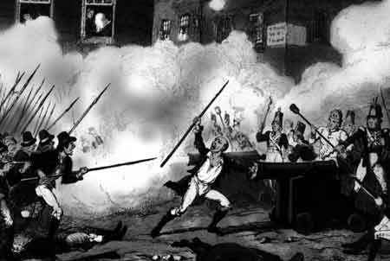
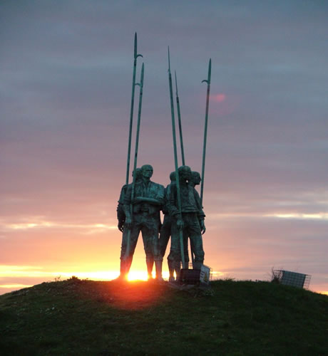
Éirí Amach 1798

Slide 2
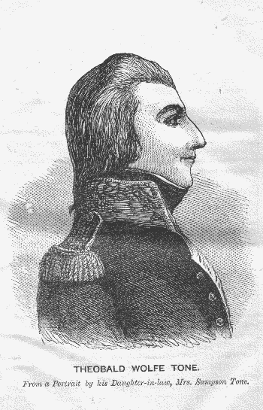
http://www.teachnet.ie/jheffernan/2006/

Slide 3
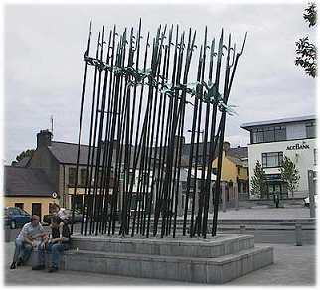
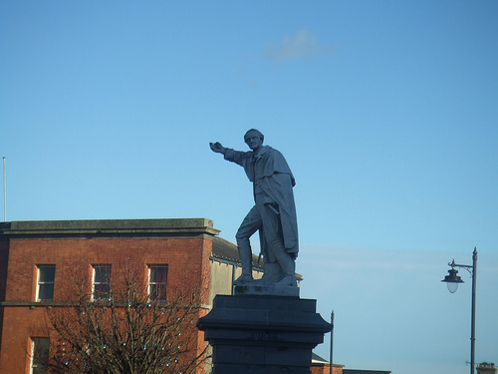
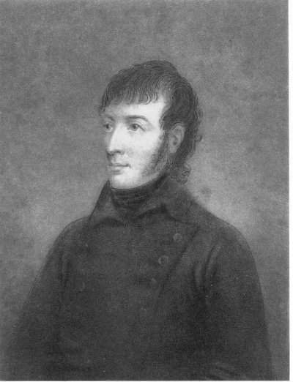
“Rí na gCroppies”
An tAthair Ó Murchú

Slide 4
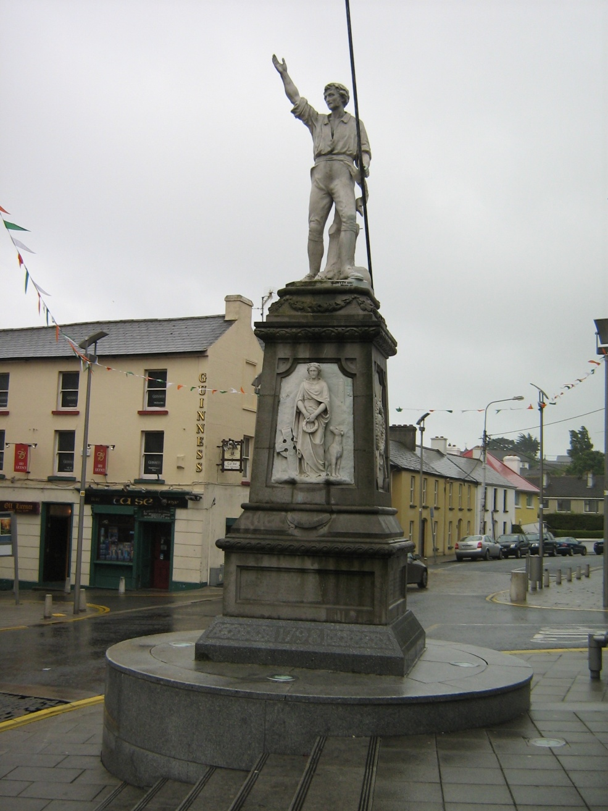
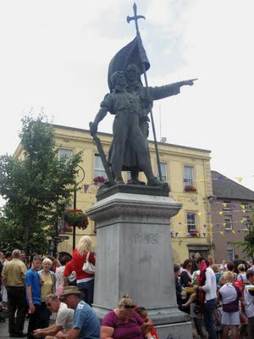
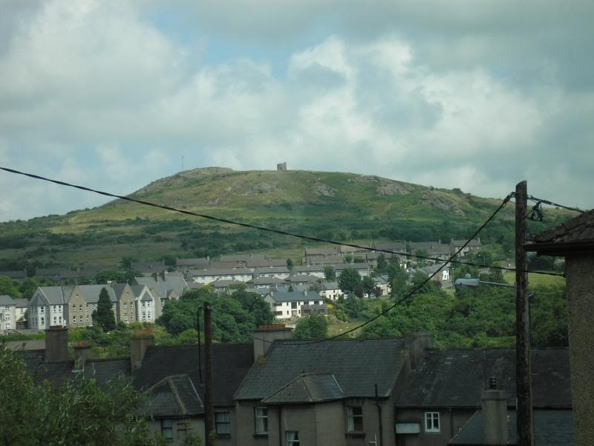

Slide 5
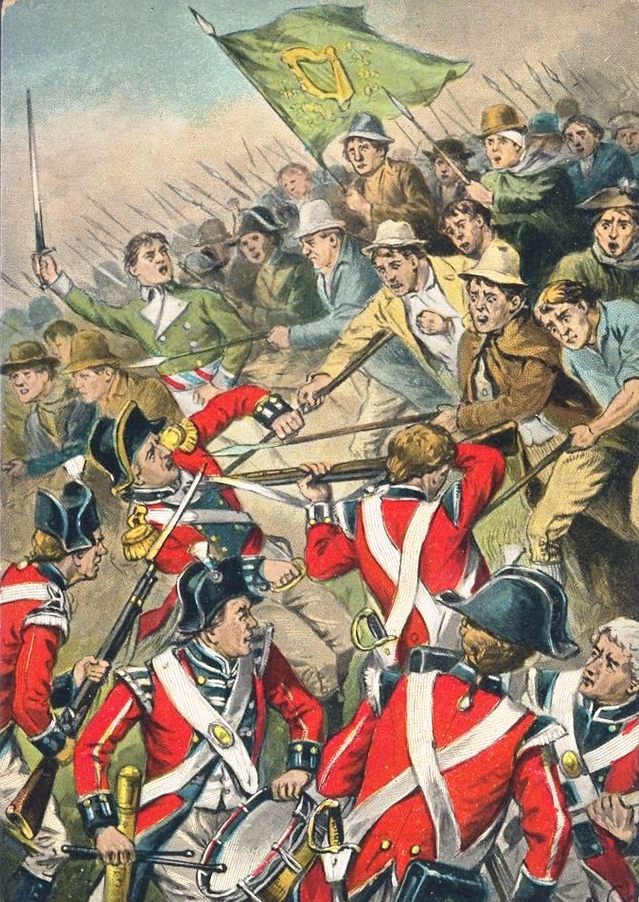
The Battle of Vineagar Hill, Co. Wexford,
21st June 1798.
“The insurgents occupied the hill, down the slopes of which they repeatedly drove their assailants, but, lacking ammunition, were themselves ultimately compelled to retire before superior numbers”

Slide 6
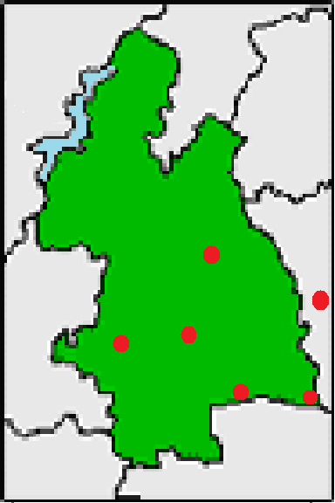
Co. Uíbh Fháillí
Co. Laoise
Co. An Chláir
Co. Thiobraid Árainn
Durlas
Co. Chill Chainnigh
Callain
Tiobraid Árainn
Caiseal
Co. Luimnigh
Carraig na Siúire
Cluain Meala
Co. Chorcaigh
Co. Phort Láirge

Slide 7
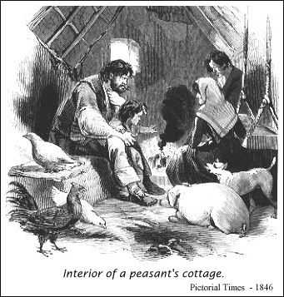
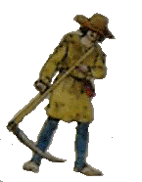
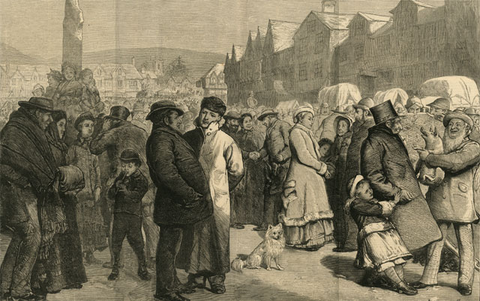
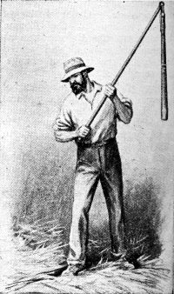
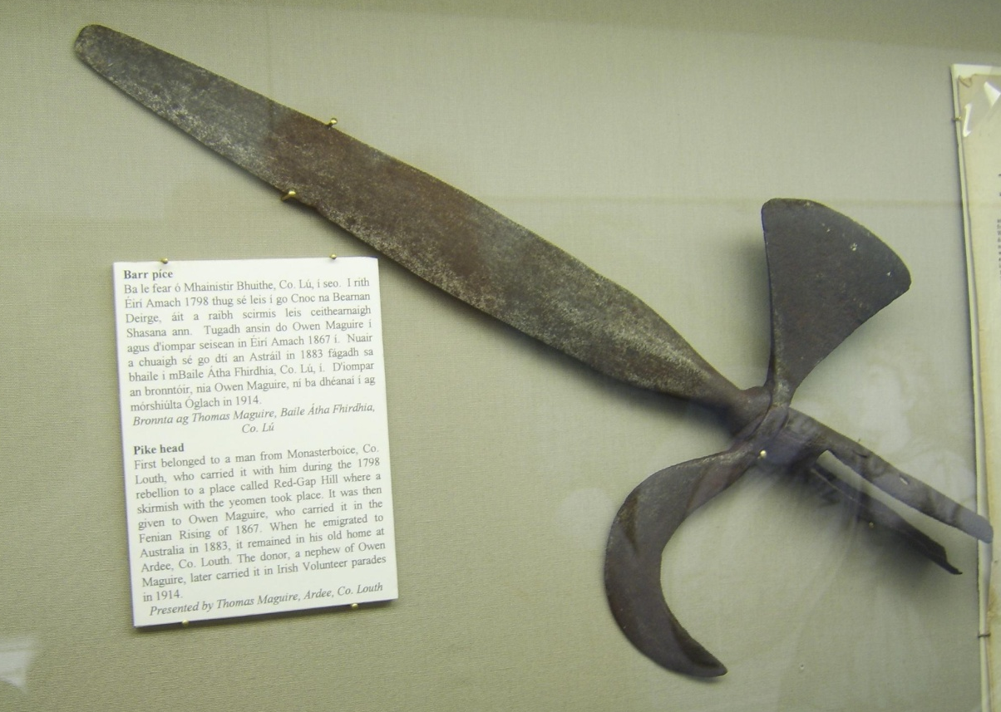
An Spailpín Fánach
súiste
barr píce
margadh na saoire – margadh hireálta

Slide 8
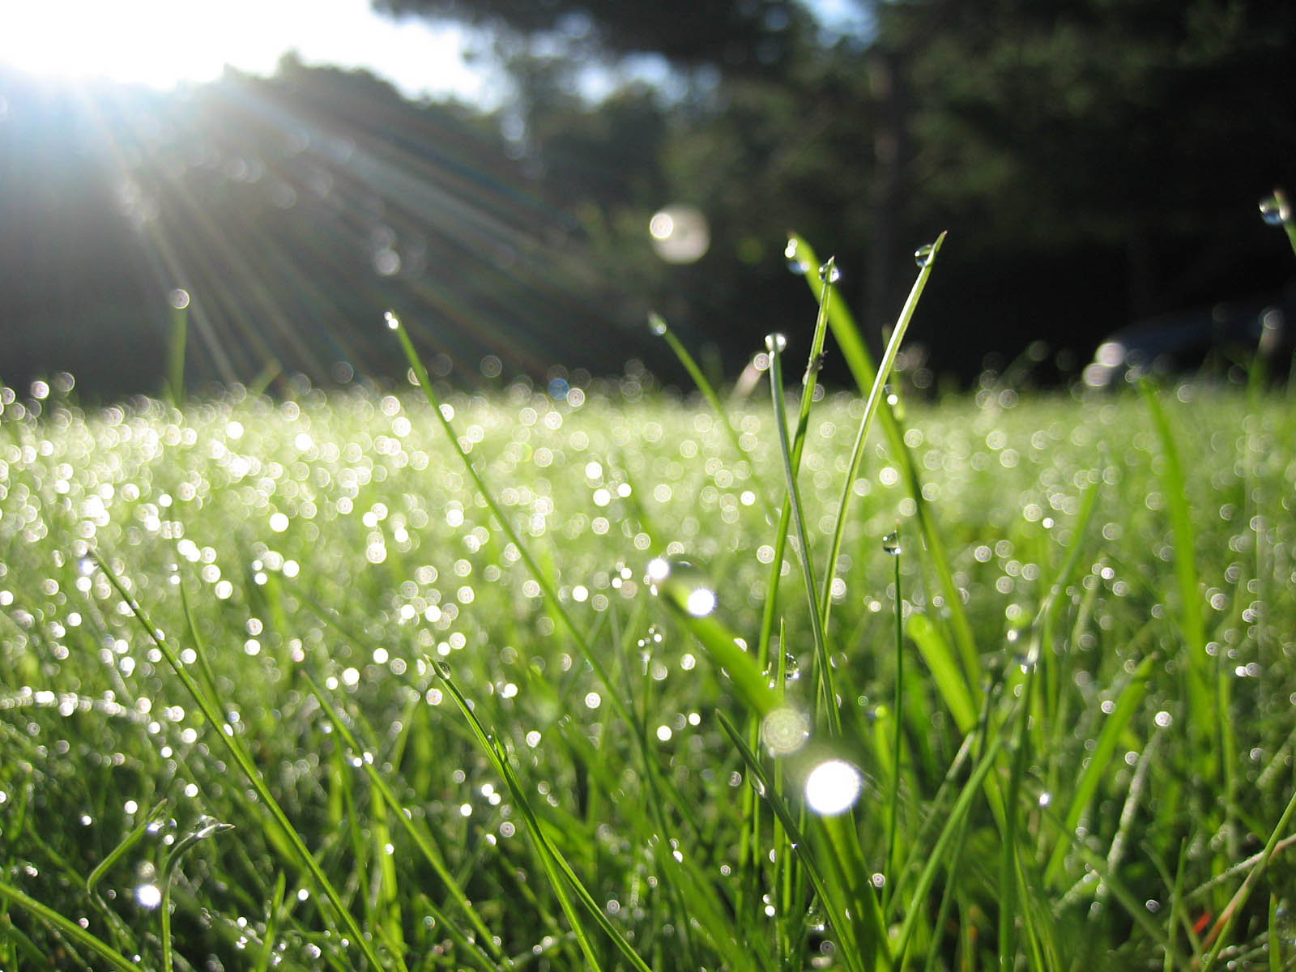
drúcht

Slide 9
faoi shúistí gall – oppressed by foreigners
Faoi chois ag na Gall – to be under the ‘foot’ (thumb) by the English
Faoi bhois – under the thumb

